Slide 1
Using AWS to Collect xDot data
Yuhan Qiu, Zifan Wang

Slide 2
Outline
Connect and configure the Multitech conduit.
Setup Node-Red flow and AT-firmware of xDot.
Configure LoRa on xDot.
Send xDot sensor’s data to Node-Red through LoRa.
Send xDot sensor’s data to AWS IoT and Thingsboard

Slide 3
Connect and configure the Multitech conduit.
Connect the antenna to the conduit and power to the conduit.
Use Ethernet cable connect pc and conduit.
Login to the GUI
Change LoRa WAN Networking setting
Change LoRa WAN Key Management setting
Restart the LoRa WAN

Slide 4
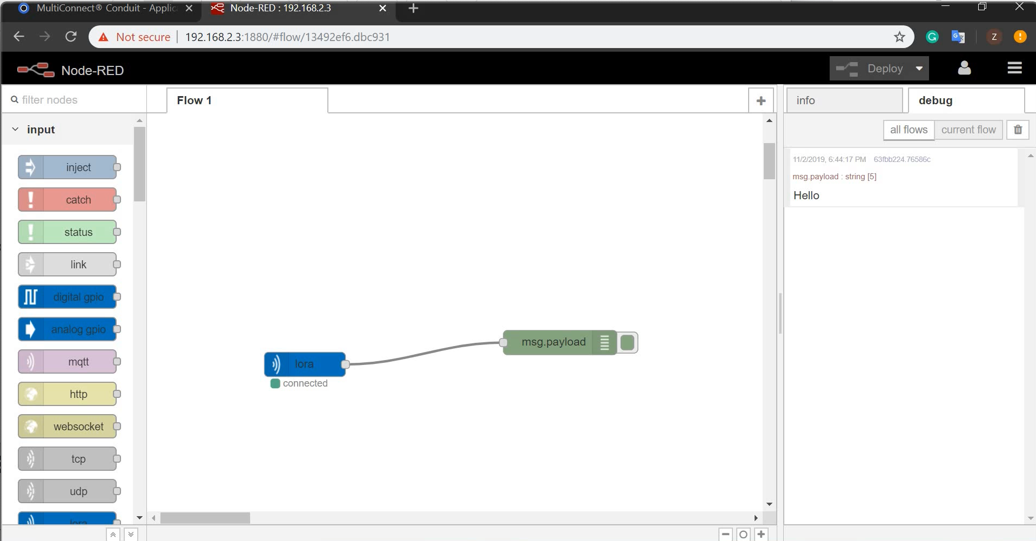
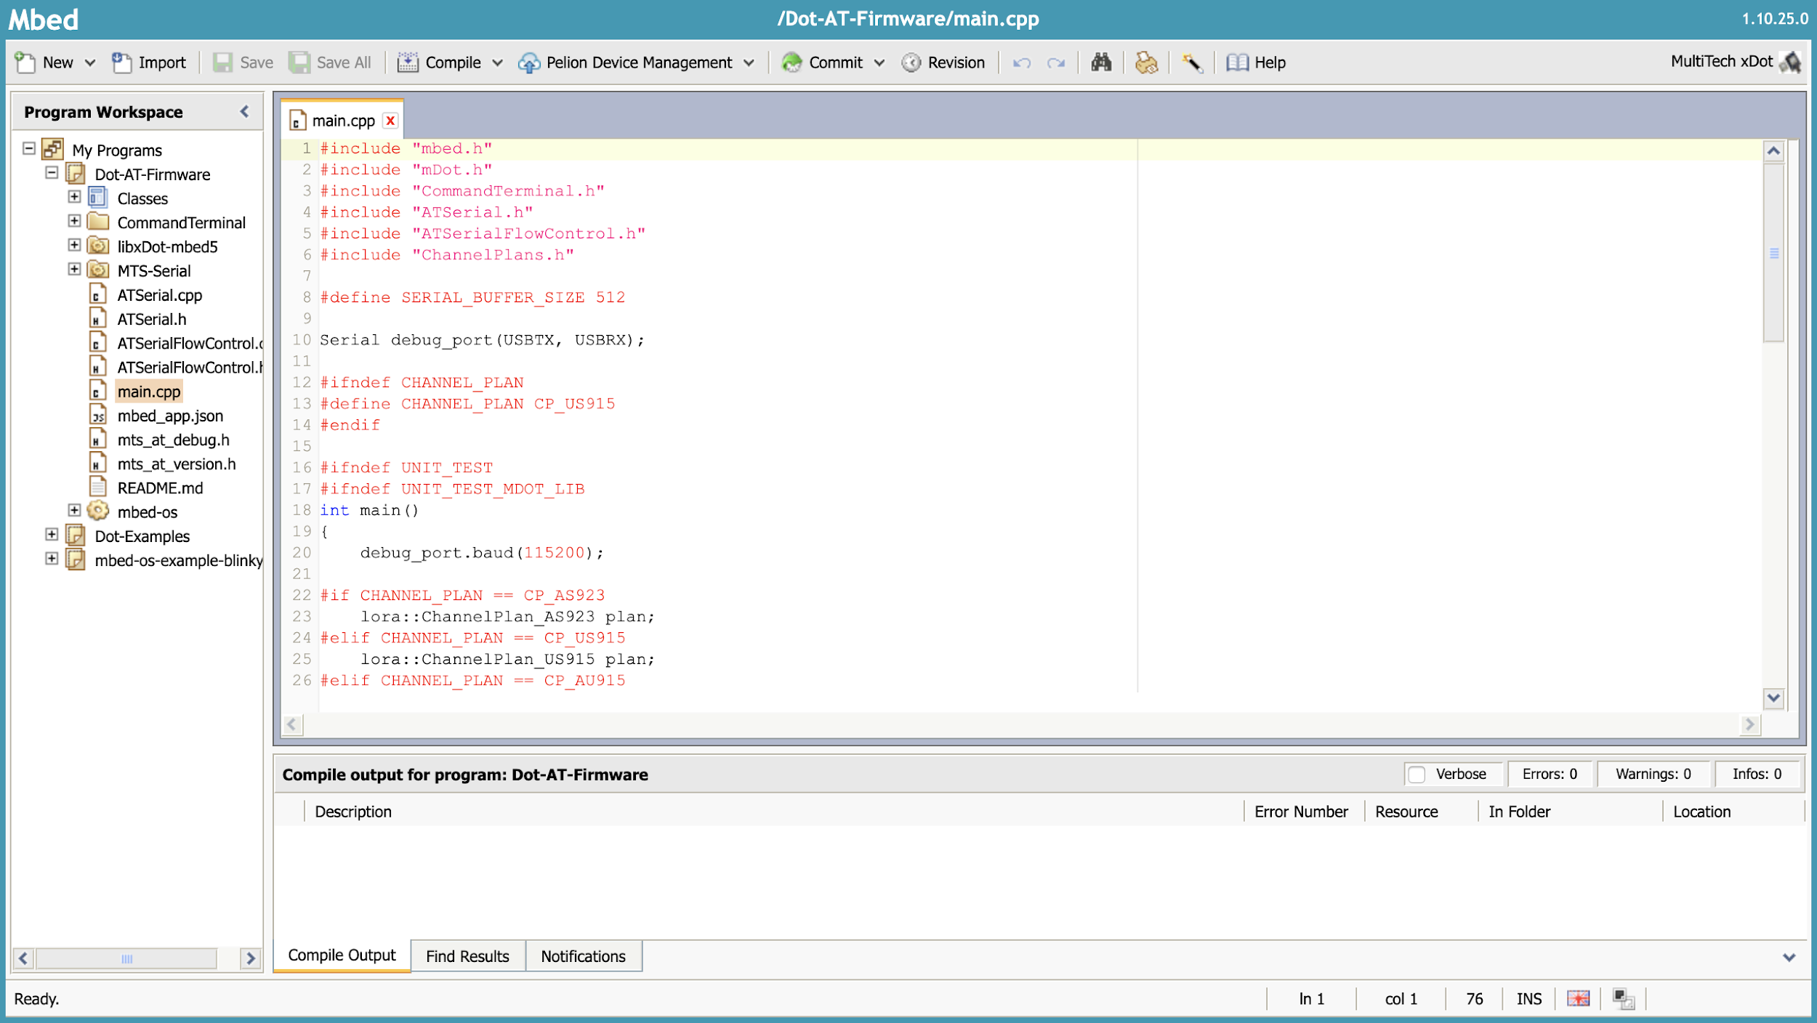
Setup Node-Red flow and AT-firmwareof xDot.
1.Import the Dot-AT-firmware
2.Import libDot-mbed5 to the same path as the firmware
3.Compile and load program to xDot.

Slide 5
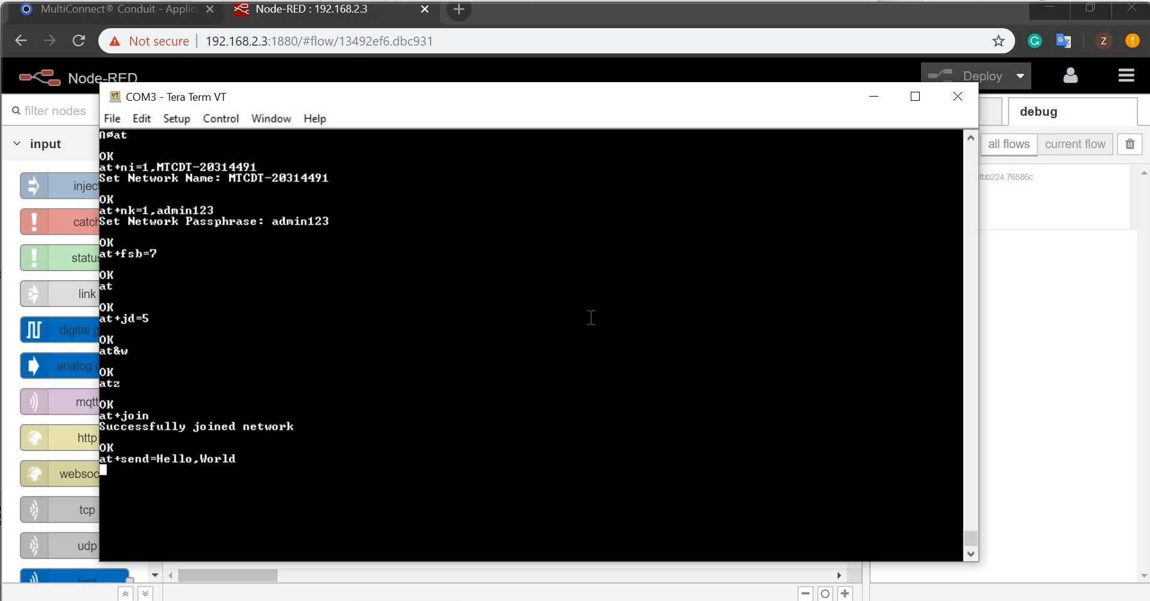
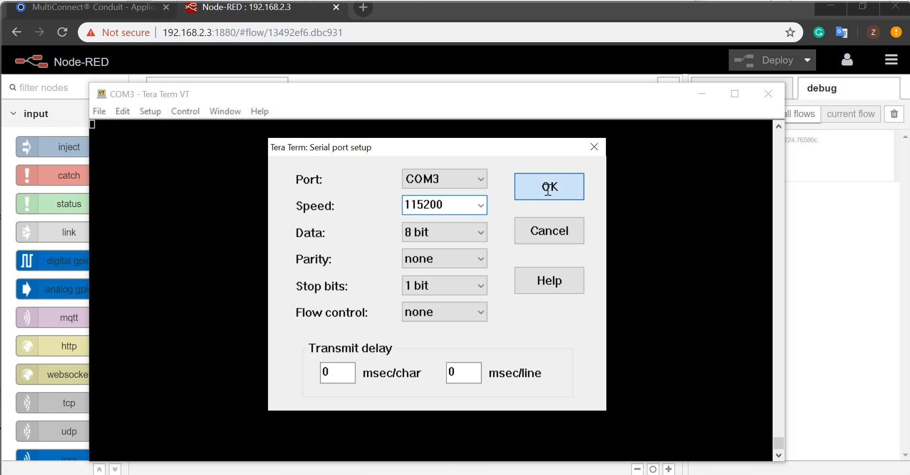
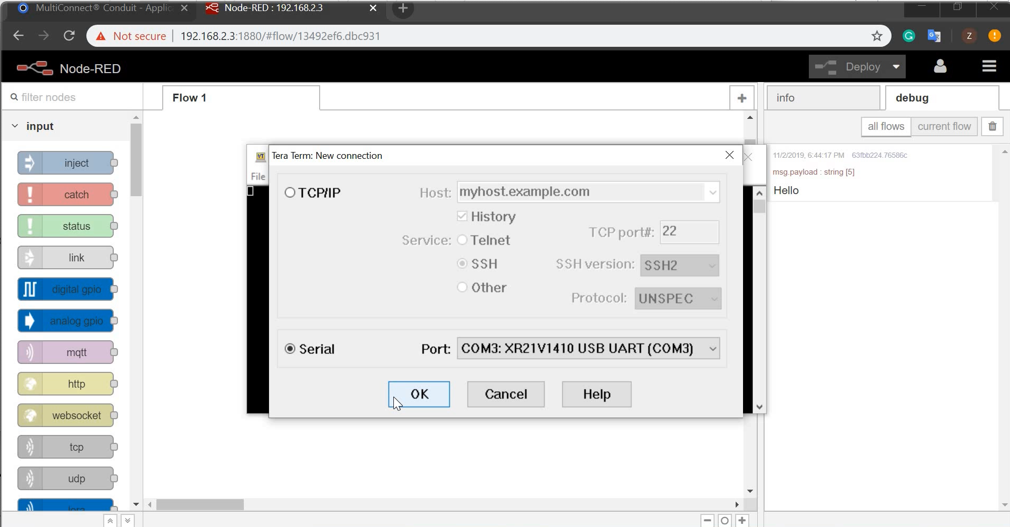
Setup Node-Red flow and AT-firmwareof xDot Result
Open a serial connection to the USB UART with a baud of 115200.
Reset xDot and type AT.

Slide 6
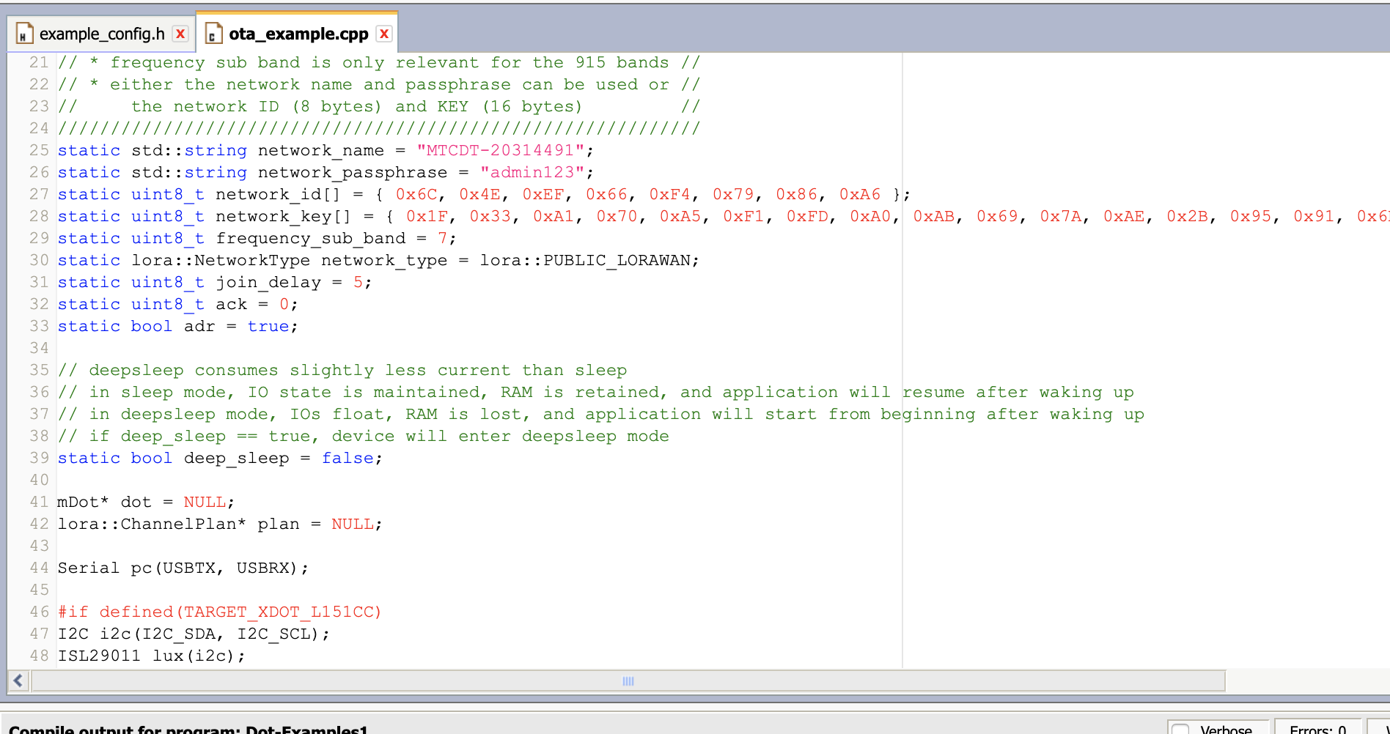
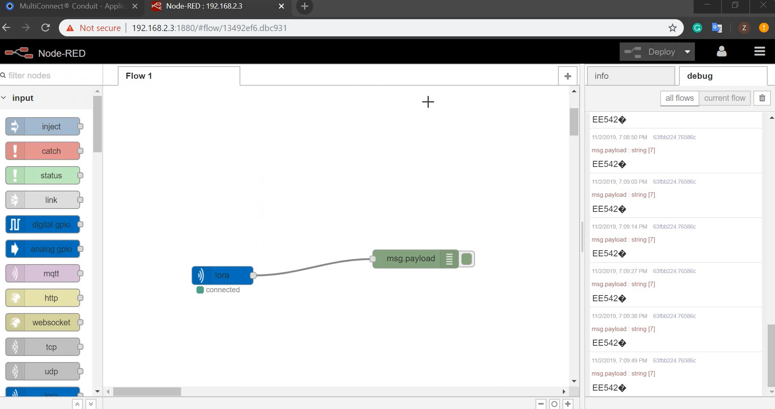
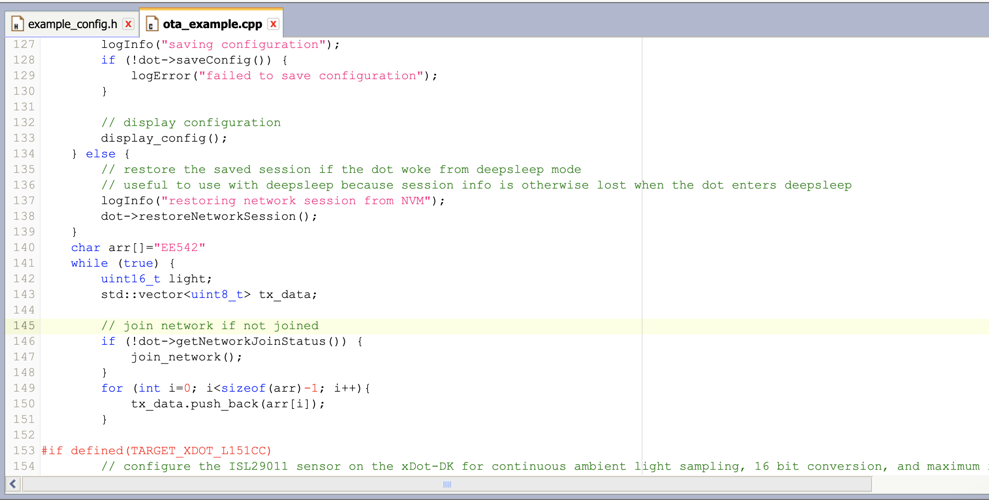
Configure LoRa on xDot
Using ATO example skeleton to configure LoRa.
Revised ota_example.cpp file. Make sure ota_example is my active example.
Send “EE542” string to the conduit through LoRa.

Slide 7
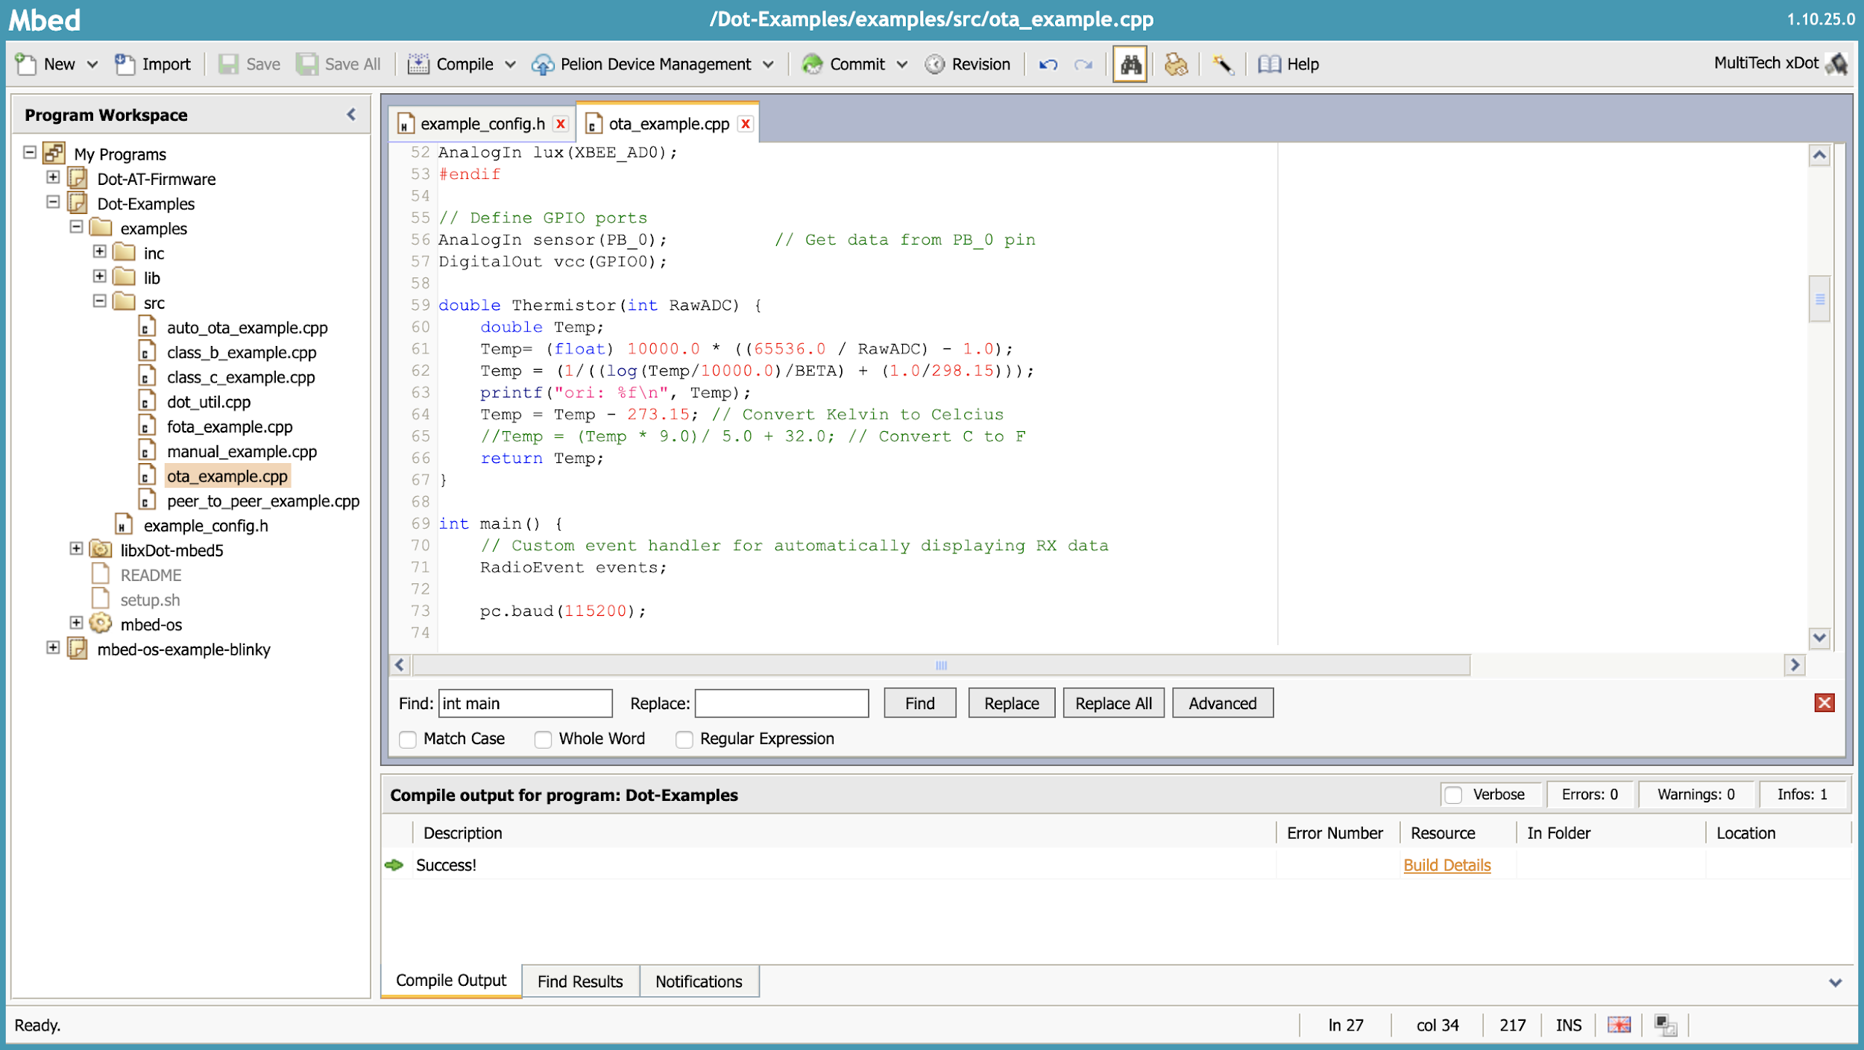
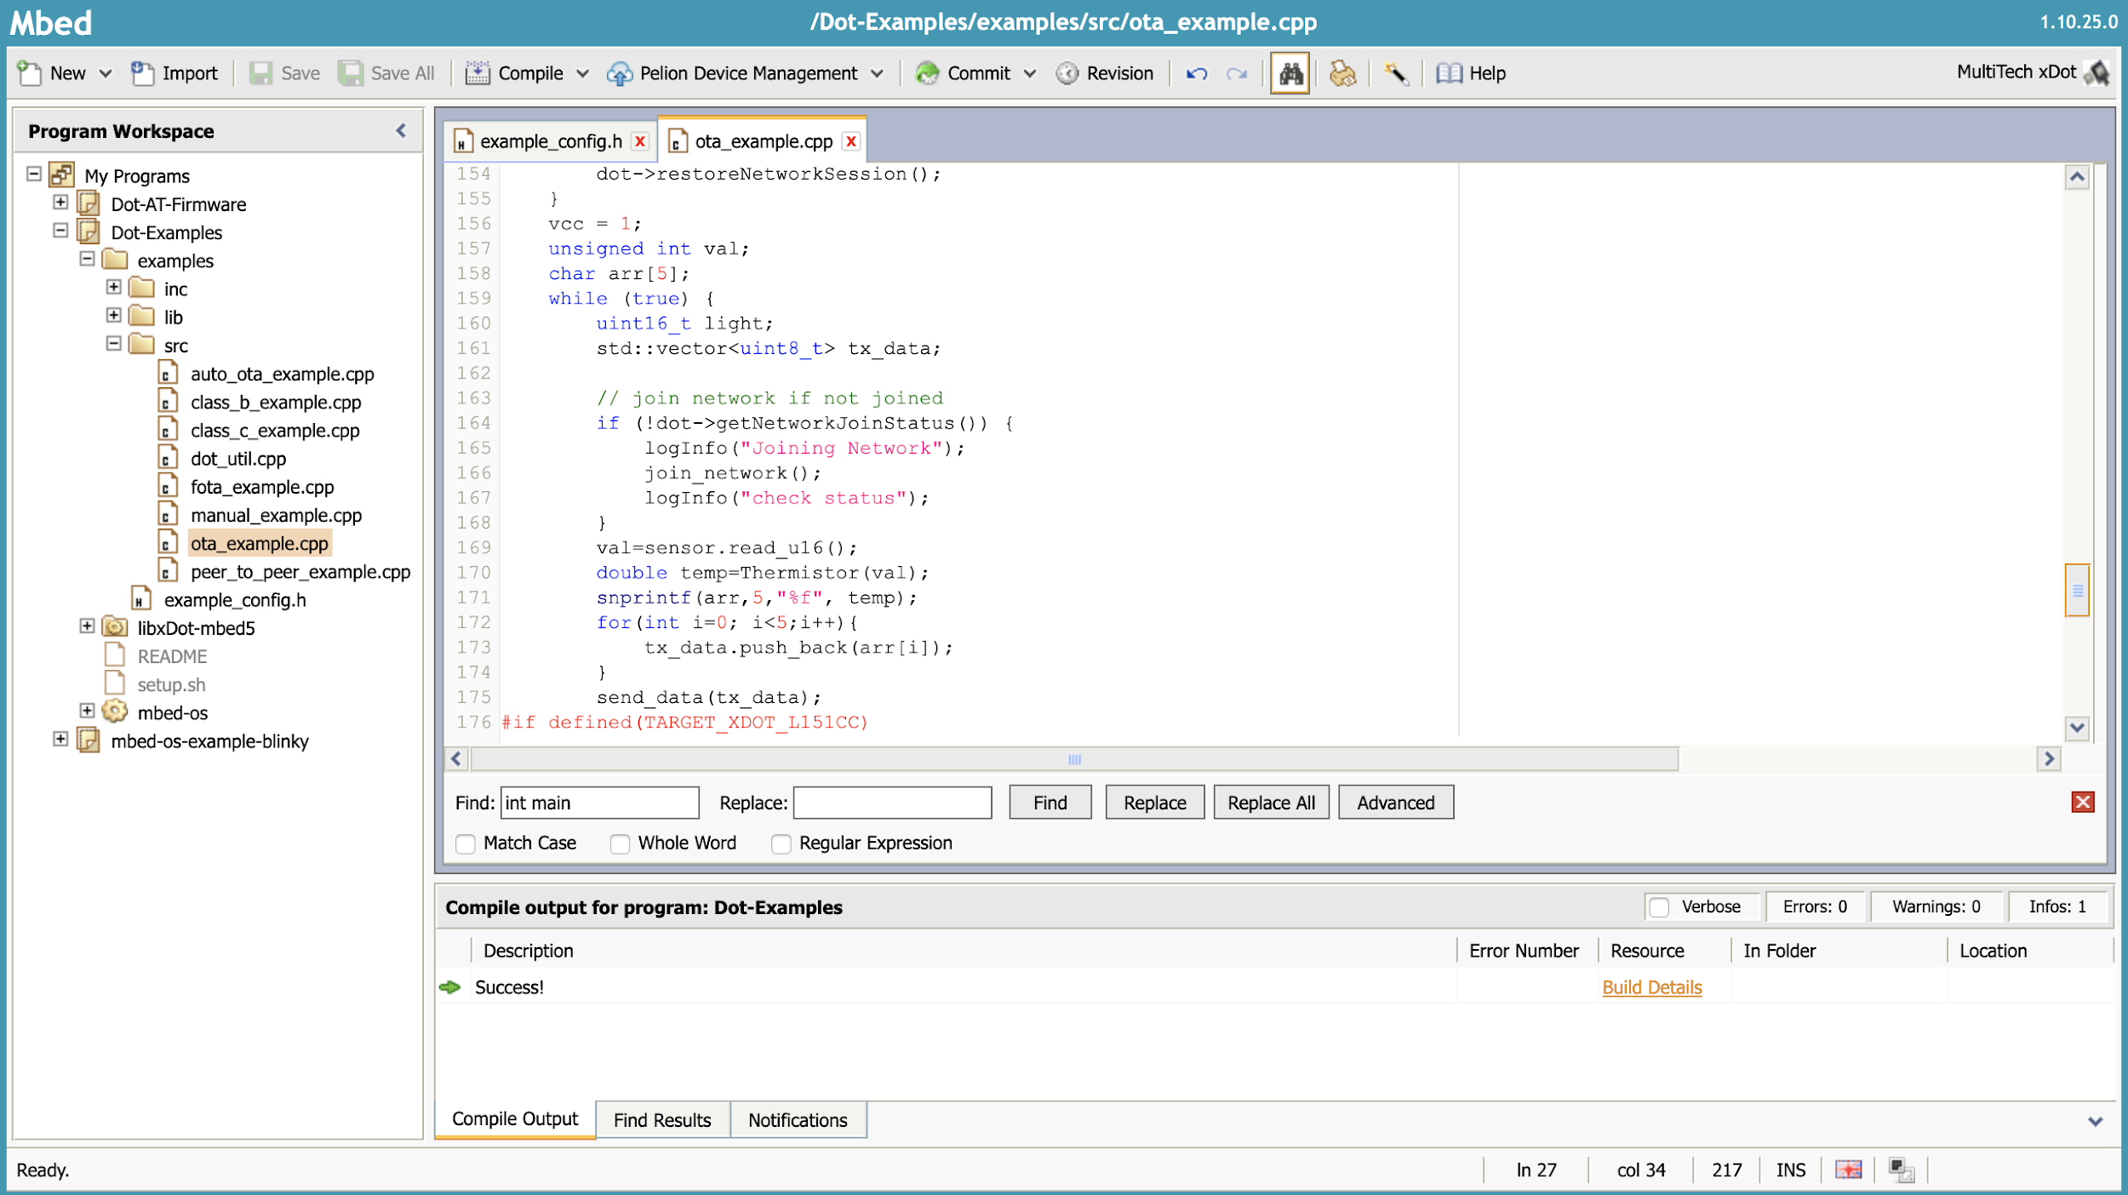
Send xDot sensor’s data to Node-Red through LoRa.
Integrate thermistor data to the ota_exapmle to send sensor data through LORa.

Slide 8
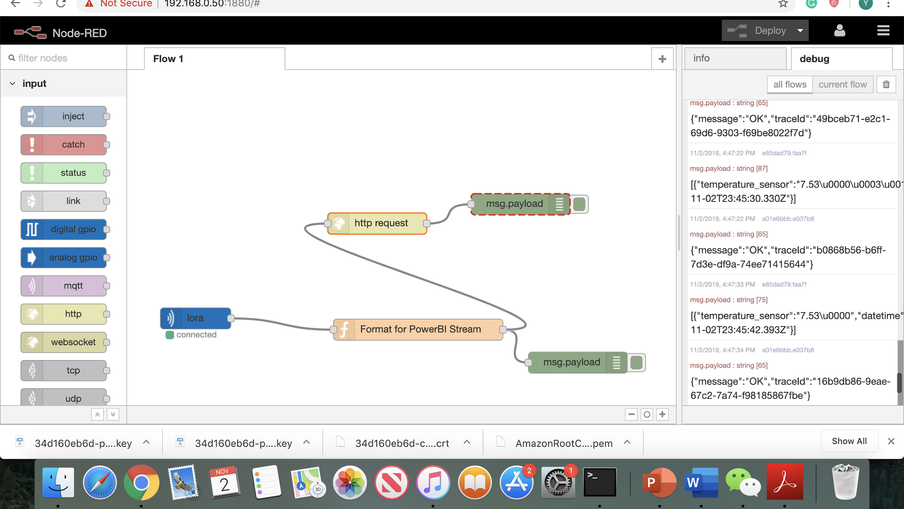
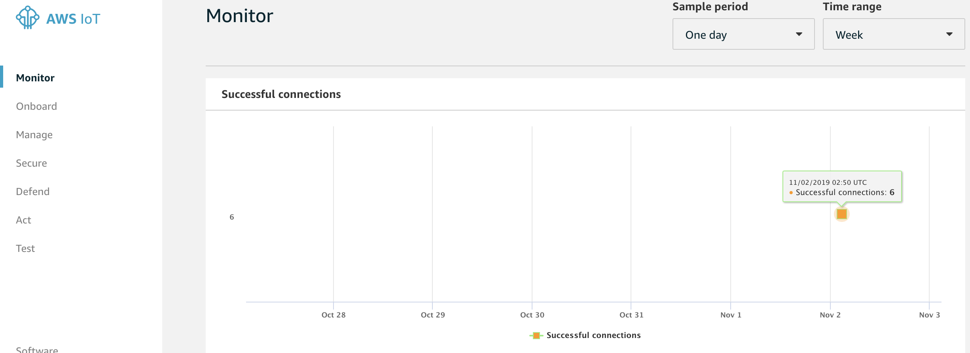
Send xDot sensor’s data to AWS IoT and Thingsboard
Create IoT things under IoT core in AWS.
Set up Node-Red flow to post data to IoT things.

Slide 9
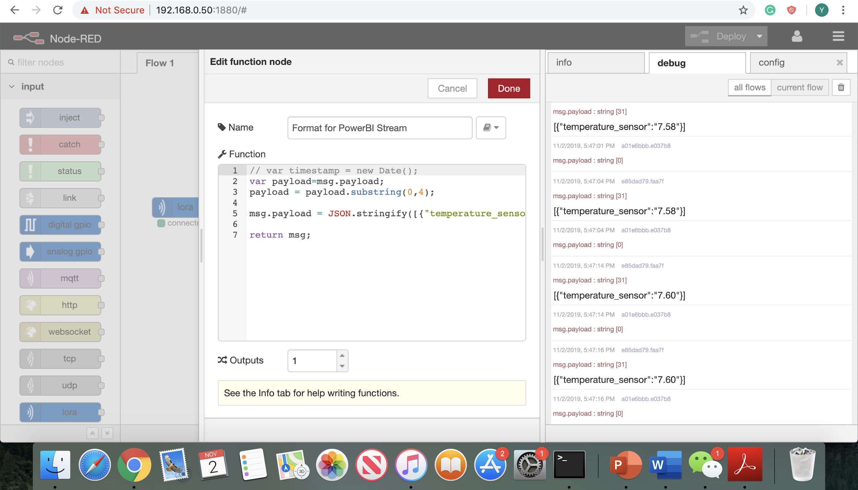
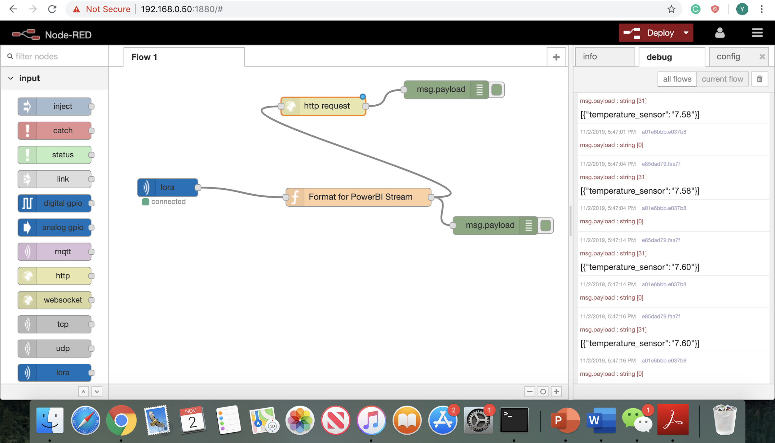
Send xDot sensor’s data to AWS IoT and Thingsboard
Set up ubuntu instance and open thingsboard GUI.
Post sensor data to thingsboard via LoRa.
Show time vs temperature chart in thingsboard.

Slide 10
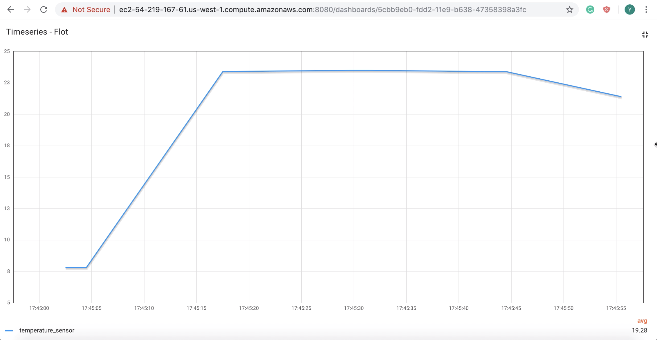
Send xDot sensor’s data to AWS IoT and Thingsboard
3. Show time vs temperature of xDot chart in thingsboard.

